Slide 1
MHS PTSA
February 5, 2024
General Meeting Updates

Slide 2
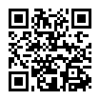
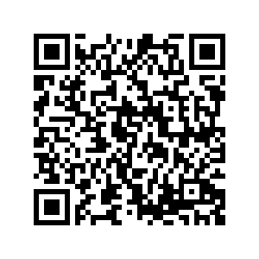
While We’re Waiting…
Sign the Attendance Sheet
Scan the QR Code for the Agenda & Minutes
Scan the QR Code to Join the PTSA!

Slide 3
Welcome!!
Since we last met…
Volunteerism - YTD just a smidge under 72% engagement rate with SUG requests (258/363)
Continued focus on facility cleaning for the next couple of months
Added the SUG Wishlist concept to our donation portfolio and it’s been well received! Thank you Hospitality!!
Eyes forward…
International Festival March 21/22
Nomination team in full swing and Kathy will provide more details
Academic Celebration - April 24/25
Final PTSA General Meeting for this school year will be Monday May 5, 7pm
Set dues amount for 2024-25
Elections
Summer volunteering events
May 22 - Incoming 9th Grade Open House

Slide 4
Nominating Committee
We are in the process of recruiting our 2024-2025 PTSA! We are actively seeking individuals from diverse cultural backgrounds with new perspectives and ideas to serve on our board. We want to ensure we can best represent the diverse families of Millbrook High School! Filling out the form does not commit you to anything but only shows your interest. One of the PTSA NomCom Members will follow up with you to answer any questions you have about the roles you are interested in! Then you decide if it will be a good fit for you!
Interested? Click here: https://bit.ly/42mTJn3
2023-2024 Nomination Committee:
Kathy Parzygnat, Chair
Sue Reynolds, Board Member
Joy Tanner, PTSA Member
Jenn Enzor, PTSA Member

Slide 5
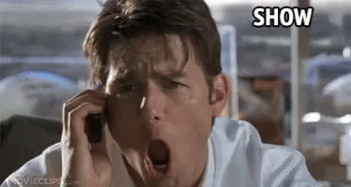
Treasurer News
Audit for quarters 1 and 2 was completed last month.
Treasurer's Report
Incredible push at end of 2023 got us to within $1,400 of our goal for No Fuss!!
Thank you to all who donated money towards staff luncheon
Awarded 7 Educator Grants this year

Slide 6
Join PTSA for $12 (higher levels available)
Connect shopping rewards cards to MHS PTSA
Harris Teeter VIC card
Givebacks program
Download app
Enter payment card
Choose MHS as your cause
Participate in Spirit Events
Monday, February 12 - Chick Fil A on Falls of Neuse
5-7pm
Create mobile order in app for pick up OR
Mention MHS at check out
Krispy Kreme Digital Dozens
Order original glazed dozen(s)
@ https://grouprai.se/krispykreme37752sb
Receive code
Redeem code at nearest KK
(Peace Street or Wake Forest)
50% of your order benefits MHS PTSA
Fundraising
Easy ways
to support
our school

Slide 7
Staff and Student Events
EVENTS SINCE START OF SCHOOL YEAR:
Newcomer Breakfast and Welcome Back Luncheon in August
Substitute Teacher Appreciation and Instructional Assistance Appreciation in September
Custodian Appreciation lunch, Staff Appreciation Luncheon, Cafeteria Worker breakfast & Halloween guessing game in October
Pick-Me-Up event with K-cups/tea in staff lounge and National Intervention Coordinator Day lunch in November
Scarves for entire MHS staff in December
Chili/soup luncheon for all staff In January
UPCOMING EVENTS:
February 12-16: Bus Driver Appreciation
February 14: Pick-Me-Up-event for teachers and staff
March 11: Breakfast drop in for teachers and staff

Slide 8
Academic Celebration
Save the date for the annual Academic Celebration!
Wednesday, April 24
Thursday, April 25
(grade levels TBD)
8am-9am
Any student who earns a 3.5 unweighted GPA at the end of 3rd quarter will be invited. Students will first gather for an assembly, then move to the café to receive their certificates and have a snack. There will be door prizes too!
We will be soliciting donations for snacks and door prizes(gift cards, movie passes, bowling party, etc.)

Slide 9
Grants
We offer educator curriculum grants, literacy grants and club grants to any teacher who is a PTA member.
Since our last meeting, we funded fluorescent light covers, doodle boards for math classes, wind ensemble music programs, special education positive behavior awards, and a club volleyball.

